Slide 1

2p-random access mesoscope (2p-RAM)
Nicholas Sofroniew and Daniel Flickinger
Svoboda lab and ID&F
08/05/2016

Slide 2
Two-photon recording of neural activity
500 um
100 um
Cranial window preparation
Neurons labeled with a genetically
encoded calcium indicator
Notes:
The preparation involves making a cranial window into the mouse (here 3mm diam) and looking at part of the brain
See how much smaller the part we can look at, if asking questions confined to one brain area that may be ok, but complex behaviors involved coordinated activity over multiple brain areas, and so simultaneous recording is necessary.
We were motivated by the availablity of transgenic GCaMP mice
Some previous efforts to expand the field of view first up to 1.2 mm and then more recently to 3 mm
So what were out specs

Slide 3
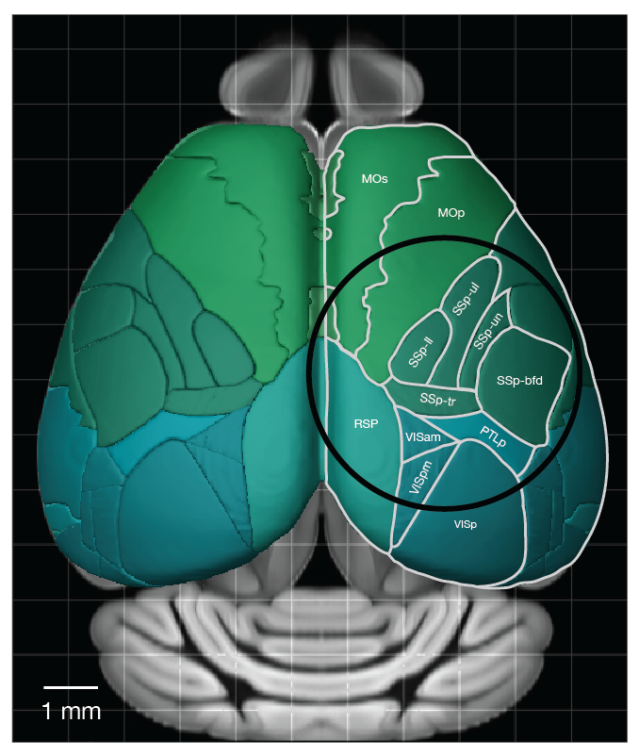
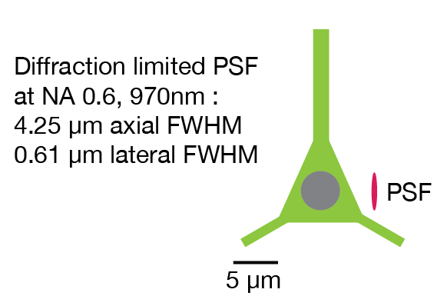
Mesoscale imaging at single neuron resolution
Key specifications:
Field of view: 5.0 mm
Depth range: 1 mm
Excitation NA: 0.6
Collection NA: 1.0
Excitation λ range: 900 nm - 1070 nm
Sofroniew* Flickinger* et al. eLife 2016

Slide 4
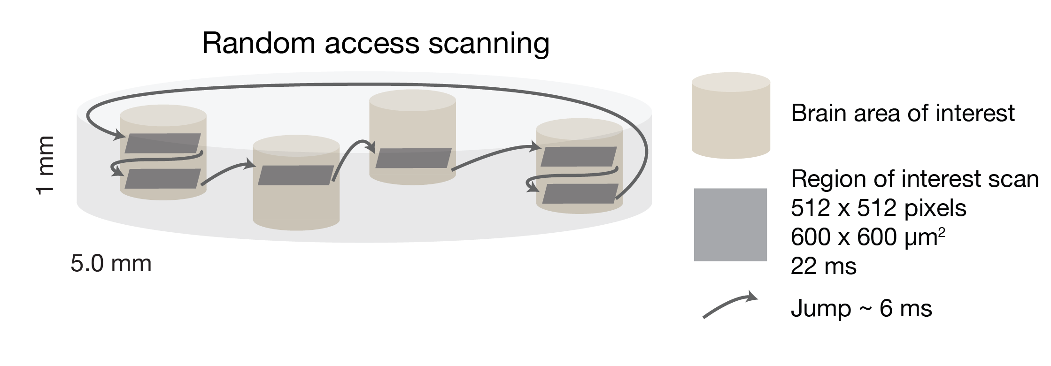
Random access scanning

Slide 5
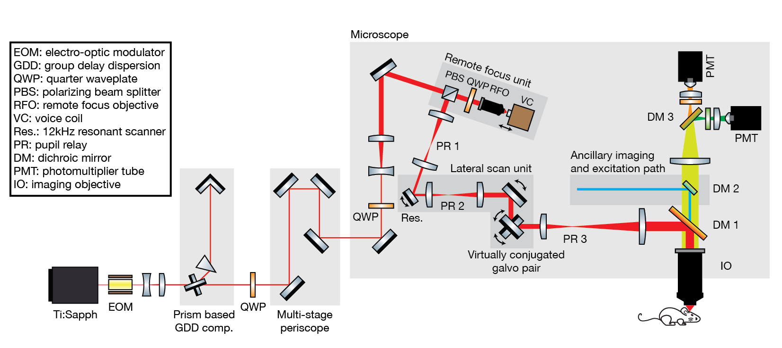
Optical layout of the 2p-RAM
(Two-photon random access mesoscope)

Slide 6
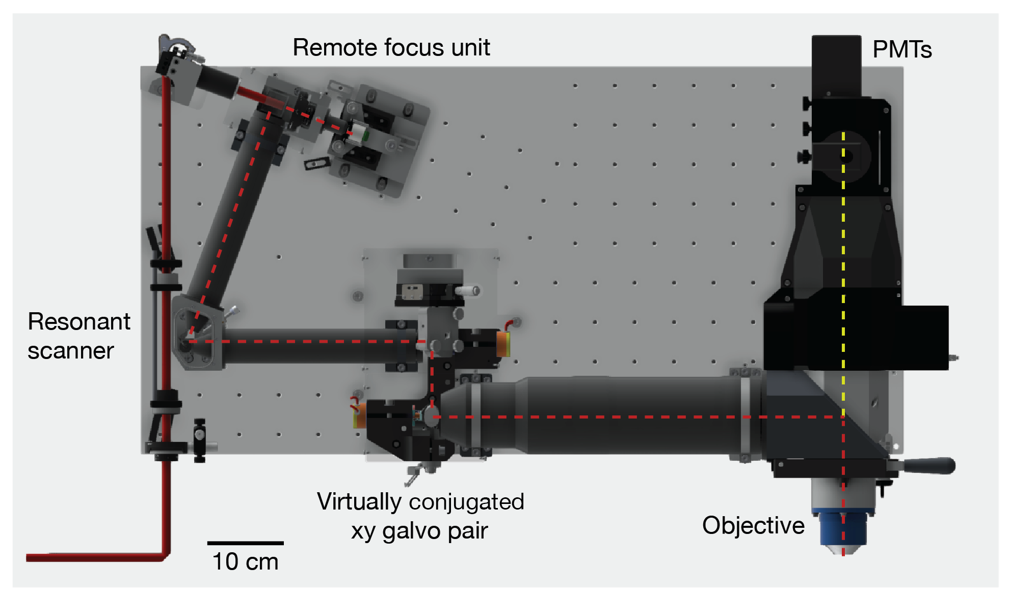
Microscope model

Slide 7
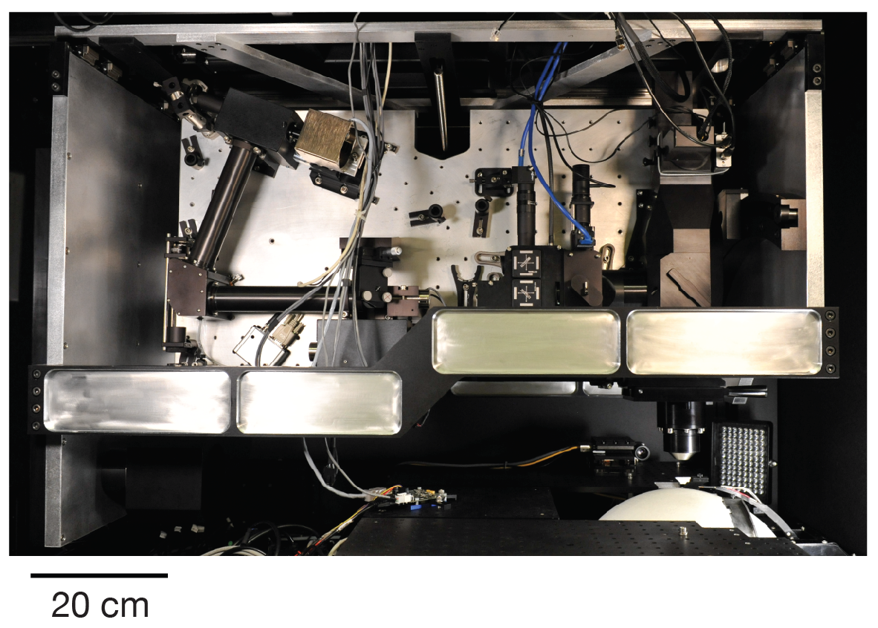
Microscope photograph

Slide 8
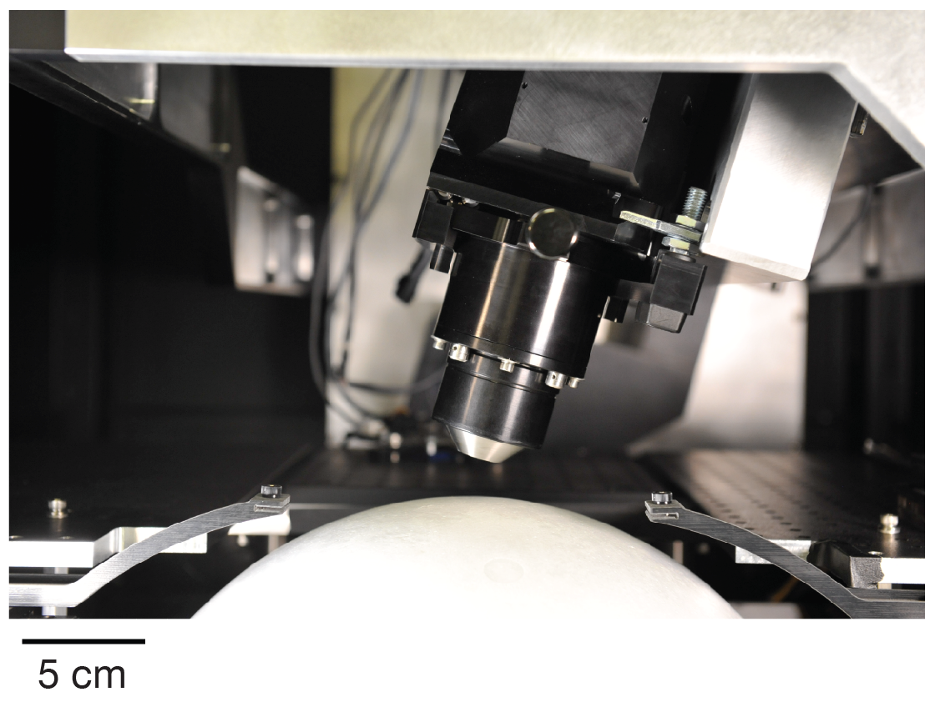
Microscope objective

Slide 9
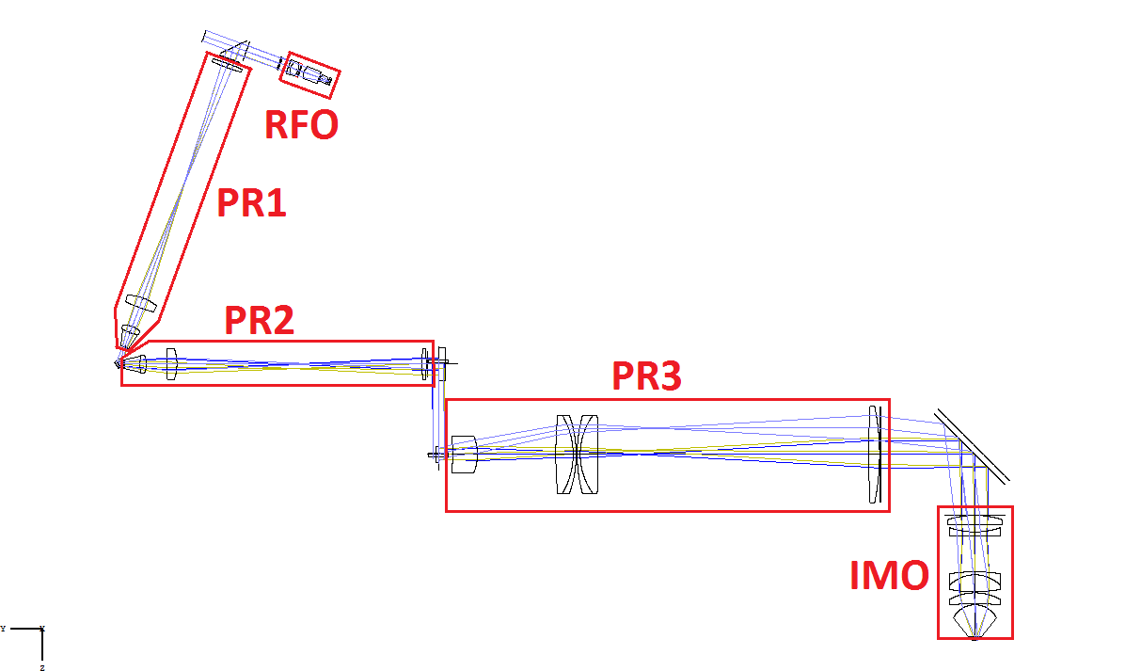
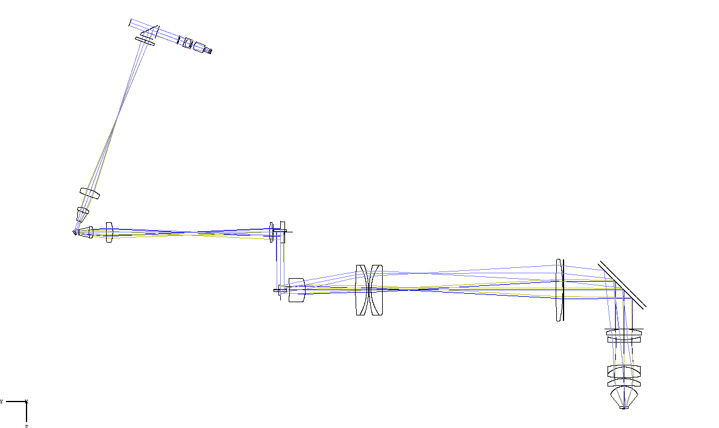
Design basics
NA: 0.6
Field curvature
2P only
Not telecentric
Minimally modularized
Fairly light-tight
Rigid
X
Notes:
Differences, unique things
Important relaxations vs. existing microscopes/mesoscope to enable economical manufacturing, and in some cases, since designing 2P microscope from ground up, to make functionality that is better than a std 2P microscope
NA: no difference seen between 0.8 and 0.6 using 16x obj
Field curvature: basically “natural”. Correctable by fast focus shifting. See data and details in last section of talk.
Working distance: more would be better, but this and field curvature were “locked in” with lens design early on
2P only
No visible support for excitation optics
No use for or access to intermediate image plane
“Tube lens” and imaging objective not allowed to move relative to one another (related to VCGG and module/module alignment later)
Move entire microscope!
Could put on static rotation stage
Design is not telecentric
Only weakly modularized—any optics by themselves will not be very useful in other systems
Minimize number of elements [count out on screen]
It’s probably possible to design new objective or objective pair that would work with the rest of the optics
Fairly light-tight
Chromatic correction—constrained by PTD only
Achromatic, not apochromatic
Not sure if this is a relaxation—see next slide

Slide 10
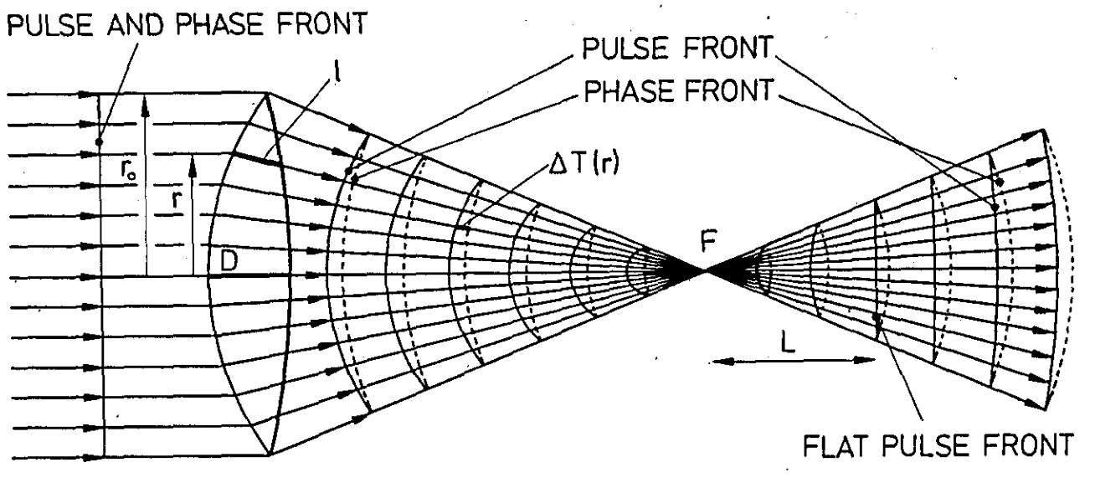
PTD: Propagation Time Difference
Z. Bor, Optics Lett. 14 (3) 1989; Z. Bor, J. Mod. Optics, 35 (12) 1988.
Notes:
Dispersion causes the group velocity to be slower than the phase velocity
The shape of pulse fronts and phase fronts become different after traversing an optical system
PTD is the difference between the phase front and pulse front, and in our usage we remove the constant/piston term
For an achromatic lens, at the wavelength at which the focal length is stationary, the PTD is constant
Theoretical analyses of PTD only look at simple lenses, on-axis, using paraxial approx. (no spherical aberr) so we calculate the PTD for the actual system
RMS PTD < 20 fs anywhere in field
Pk-Pk PTD < 60 fs

Slide 11
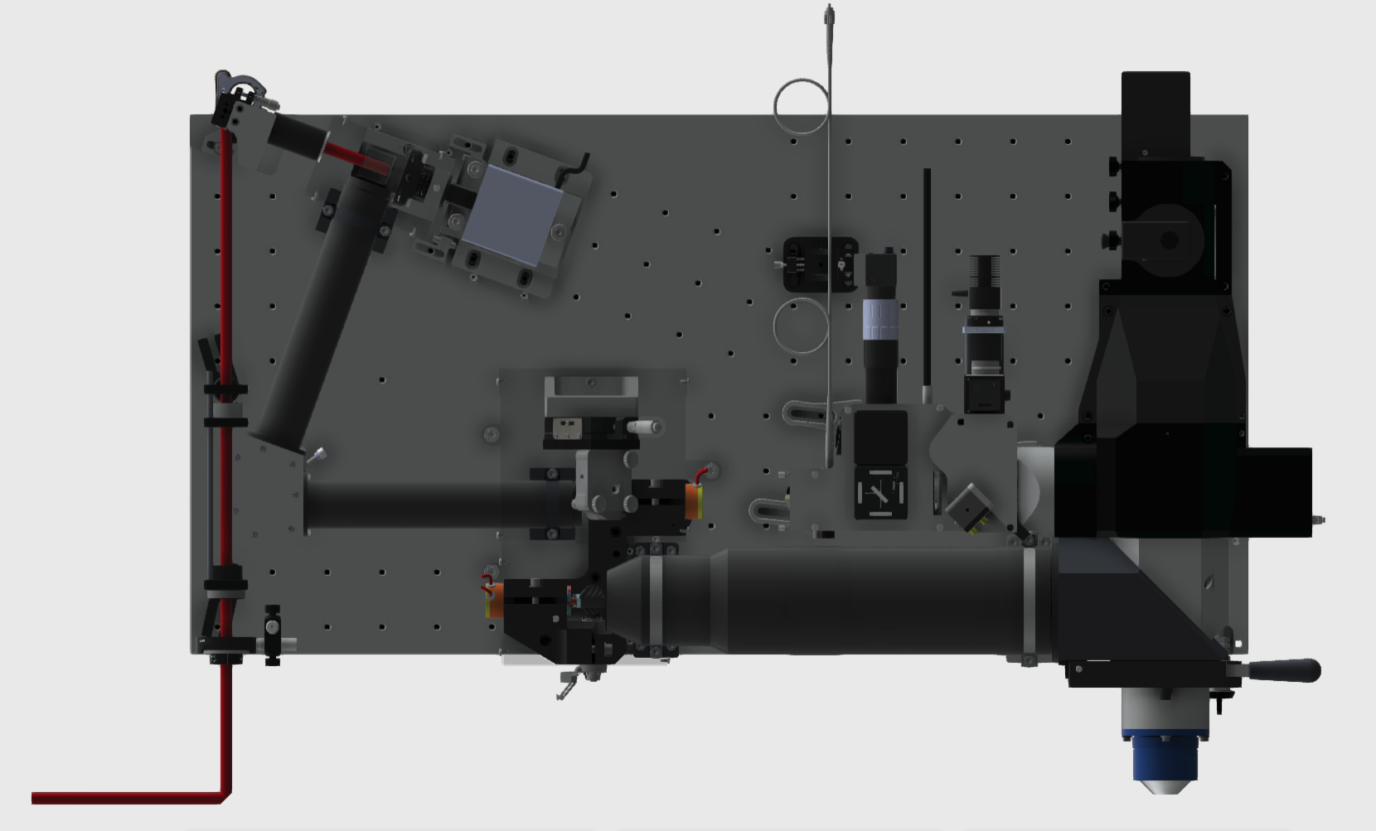
Non-scanned remote focusing
Notes:
Dispersion causes the group velocity to be slower than the phase velocity
The shape of pulse fronts and phase fronts become different after traversing an optical system
PTD is the difference between the phase front and pulse front, and in our usage we remove the constant/piston term
For an achromatic lens, at the wavelength at which the focal length is stationary, the PTD is constant
Theoretical analyses of PTD only look at simple lenses, on-axis, using paraxial approx. (no spherical aberr) so we calculate the PTD for the actual system
RMS PTD < 20 fs anywhere in field
Pk-Pk PTD < 60 fs

Slide 12
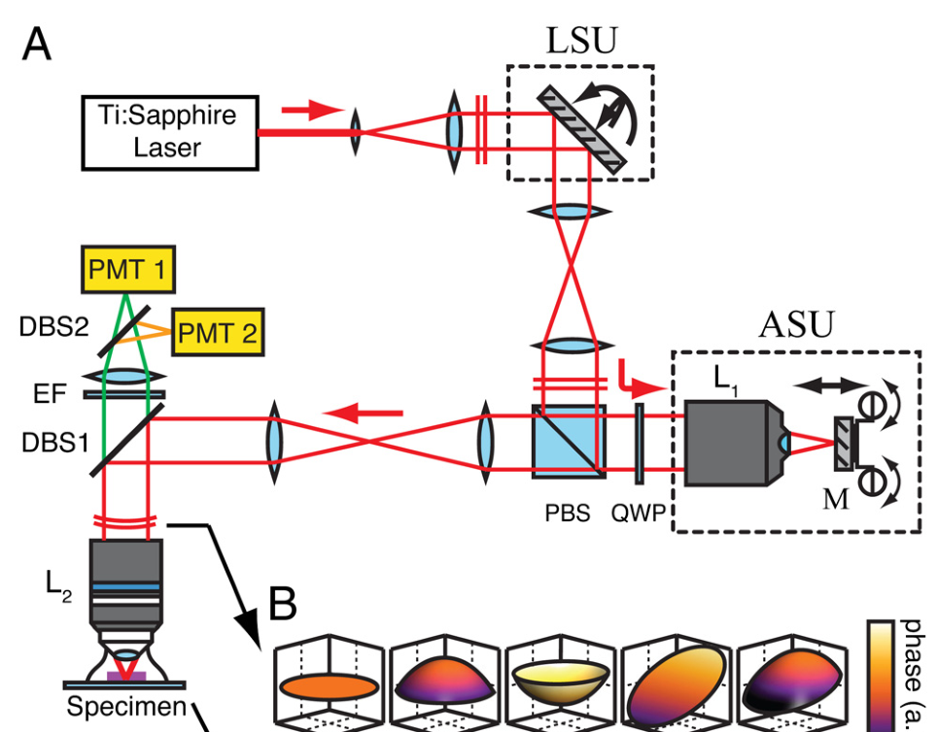
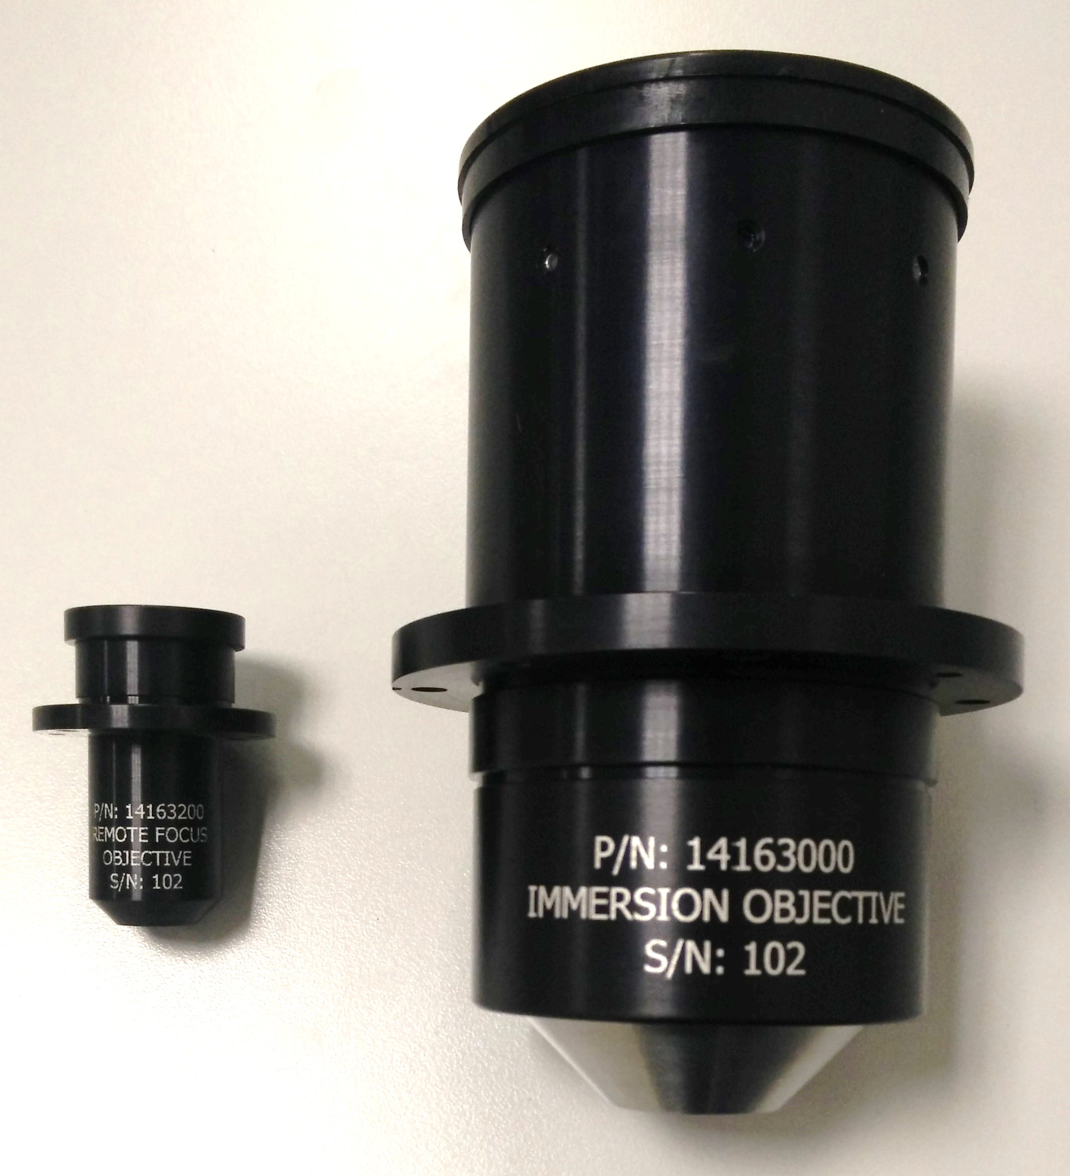
Non-scanned remote focusing
E. Botcherby et al, Proc. Nat. Acad. Sci. USA 109 (8), 2012.
Notes:
Why RF in first place: 500um of defocus at sample is about 70 waves of sag.
Phase wrapping—100fs pulse only 30 cycles long.
Deformable mirror: saw significant connection between defocus and chromatic aberration
Smaller RF objective
Not a given that it would work, but we found design that did
M!=1. Had to limit RF mirror stroke.
Good transmission 97% – optimized for IR light and low element count
Mention choice of voice coil over flexure driven stage
Main advantage being no need for self-assembly and tuning
Other potential benefit/problem—not scanning over mirrors removes dust from images, but probably makes laser damage more likely

Slide 13
Virtually conjugated galvo scanner pair
Notes:
Dispersion causes the group velocity to be slower than the phase velocity
The shape of pulse fronts and phase fronts become different after traversing an optical system
PTD is the difference between the phase front and pulse front, and in our usage we remove the constant/piston term
For an achromatic lens, at the wavelength at which the focal length is stationary, the PTD is constant
Theoretical analyses of PTD only look at simple lenses, on-axis, using paraxial approx. (no spherical aberr) so we calculate the PTD for the actual system
RMS PTD < 20 fs anywhere in field
Pk-Pk PTD < 60 fs

Slide 14
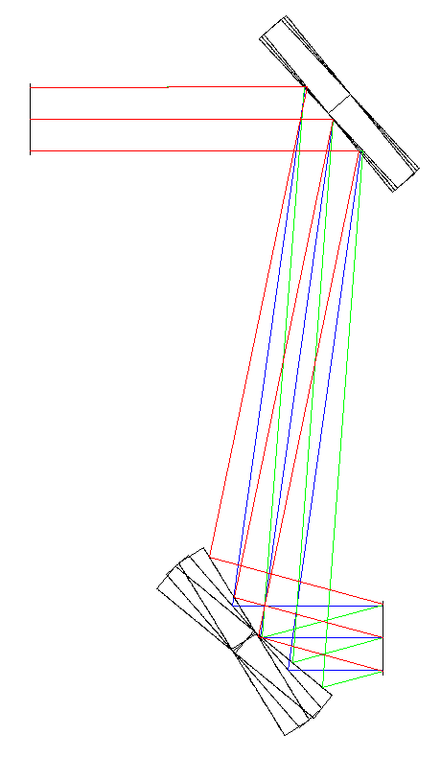
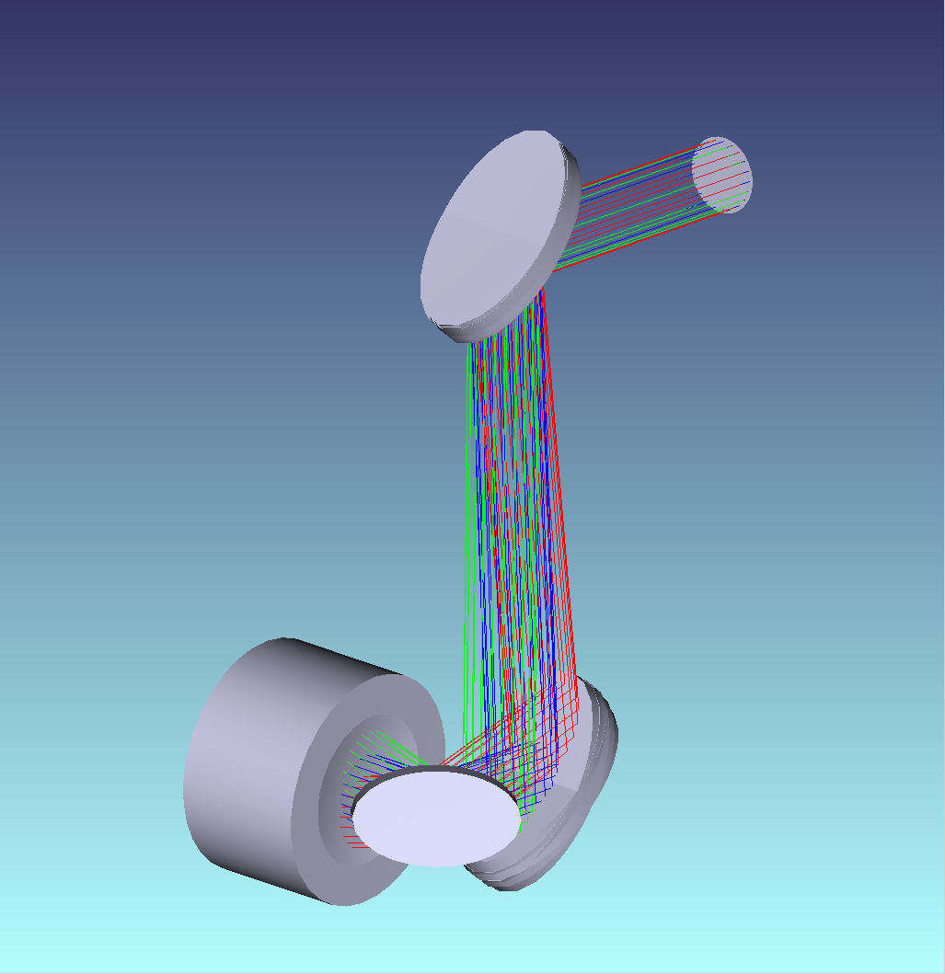
Virtually conjugated galvo scanner pair
Y1
Y2
X
Notes:
When non-planar wavefronts are used at the pupils, all pupils/scan mirrors need to be imaged onto one another
Talk about how / why it works, why we did it, one schematic
Strict proportionality, talk about voltage divider
PRIOBABLY NOT: Not perfect—distance changes, but this is tolerated.

Slide 15
Module / module alignment tolerances and compensation
Notes:
Everything thoroughly toleranced—beyond scope of this talk
Tolerances for aligning optic modules to one another found to exceed reasonable machining tolerances, when focused far away from “natural focus”
Compensators: Reasonable machining tolerances were added to model, and least sufficient set of adjustments were found– least degrees of freedom to make it work
Looked for stuff which was already easy to move, or already hard to position accurately
Two angles, two positions, put in places easy to add (3 on one fold mirror, 4th on res)

Slide 16
Imaging objective
Notes:
Dispersion causes the group velocity to be slower than the phase velocity
The shape of pulse fronts and phase fronts become different after traversing an optical system
PTD is the difference between the phase front and pulse front, and in our usage we remove the constant/piston term
For an achromatic lens, at the wavelength at which the focal length is stationary, the PTD is constant
Theoretical analyses of PTD only look at simple lenses, on-axis, using paraxial approx. (no spherical aberr) so we calculate the PTD for the actual system
RMS PTD < 20 fs anywhere in field
Pk-Pk PTD < 60 fs

Slide 17
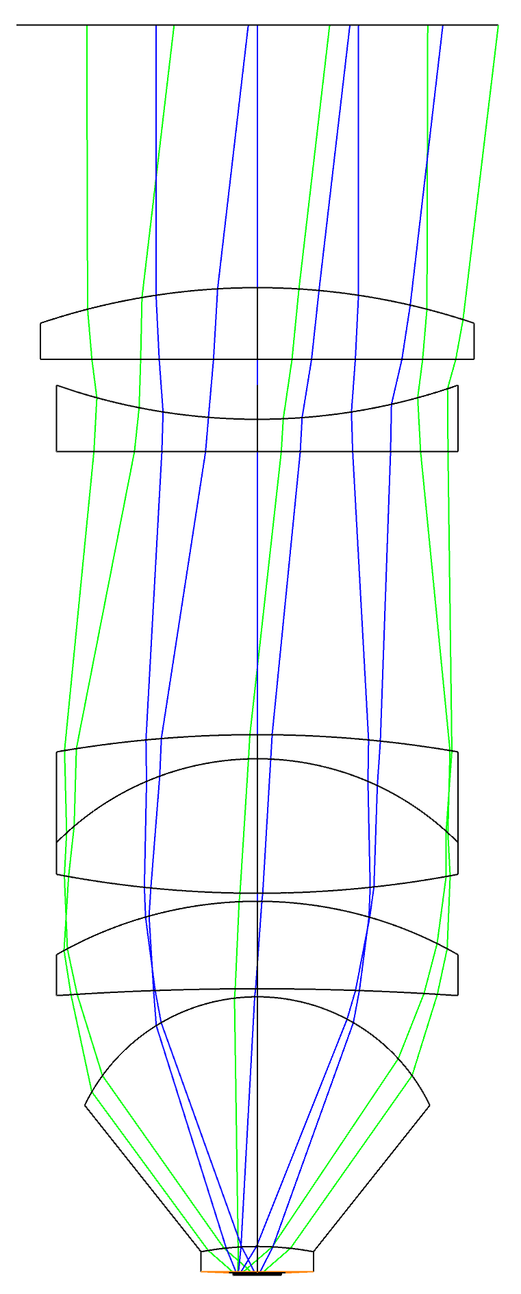
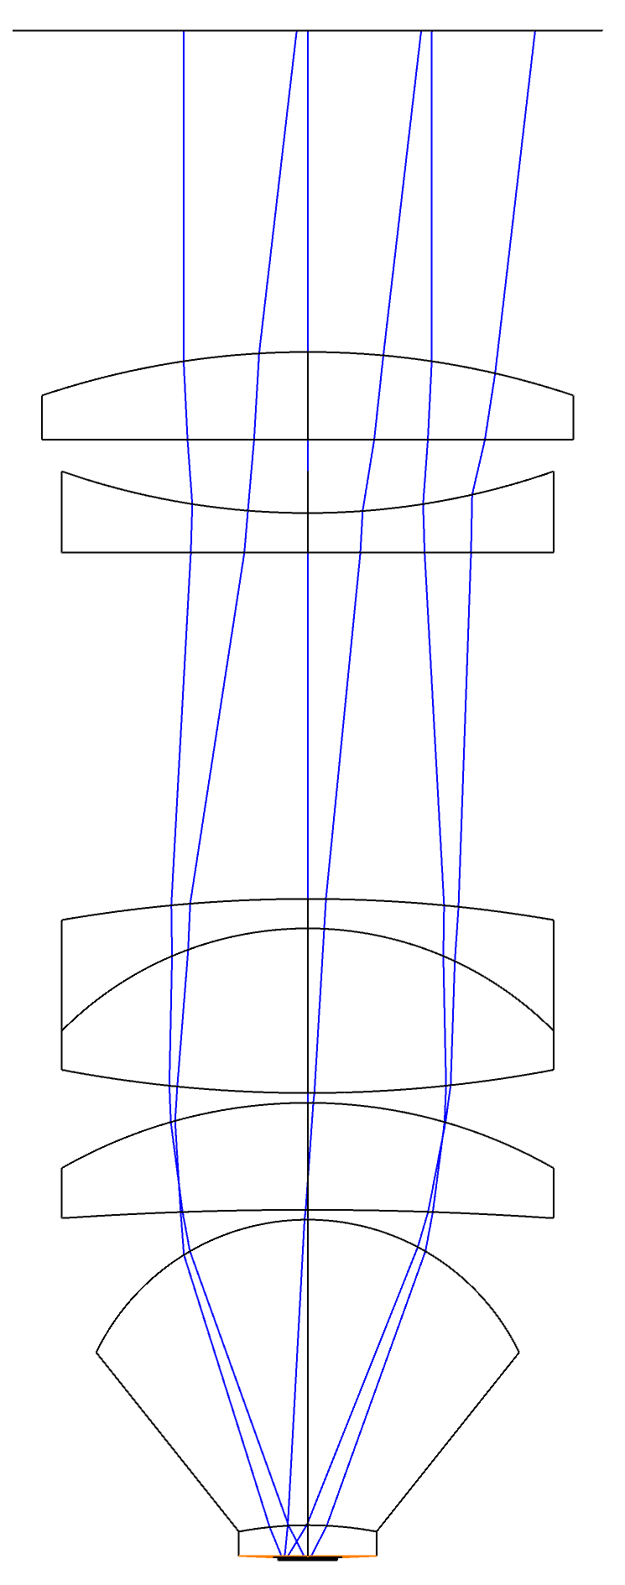
Imaging objective
Notes:
Separated imaging and collection NA !!!!! Special for 2P
Element counts, coatings
Transmission? Probably ~85-90%
Talk about pupil sizes and obj focal length?
IMO foc length ~21mm. Imaging pupil size 25mm. Collection ~42
Max scan angle at obj is 6.8 deg. At galvo it’s 15.6
Mag of PRs is all ~2.3

Slide 18
Collection optics
Notes:
Dispersion causes the group velocity to be slower than the phase velocity
The shape of pulse fronts and phase fronts become different after traversing an optical system
PTD is the difference between the phase front and pulse front, and in our usage we remove the constant/piston term
For an achromatic lens, at the wavelength at which the focal length is stationary, the PTD is constant
Theoretical analyses of PTD only look at simple lenses, on-axis, using paraxial approx. (no spherical aberr) so we calculate the PTD for the actual system
RMS PTD < 20 fs anywhere in field
Pk-Pk PTD < 60 fs

Slide 19
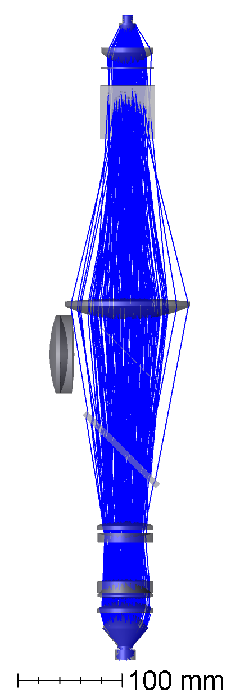
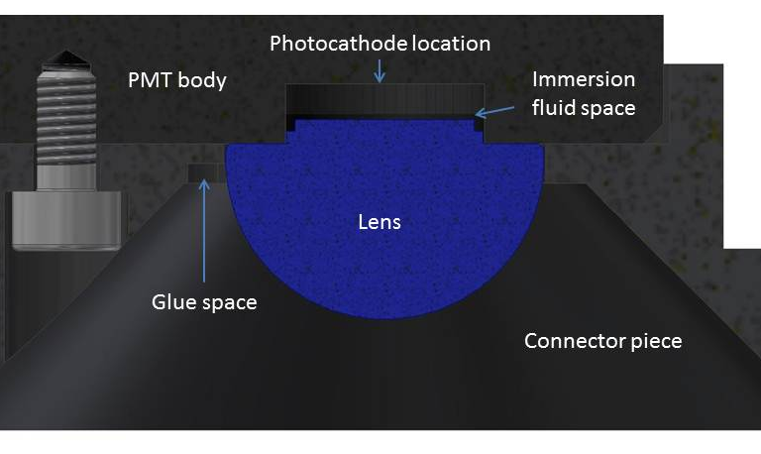
Collection optics
Ø 2 in
50 x 70 x 1 mm
52 x 72 x 1 mm
Notes:
Big – put room in for accessory optics mirror/dichroic,
allows accessory optics to not interfere with excitation optics
This optic is on “spider”
Optic sizes: as shown. Aluxa dichoric is 70x99x6mm (<$3000)
Immersed PMTs – collecting all light onto PMT cathode
NA issue, especially with aberrations in collection optics
also fixes issue with no AR coatings on PMT

Slide 20
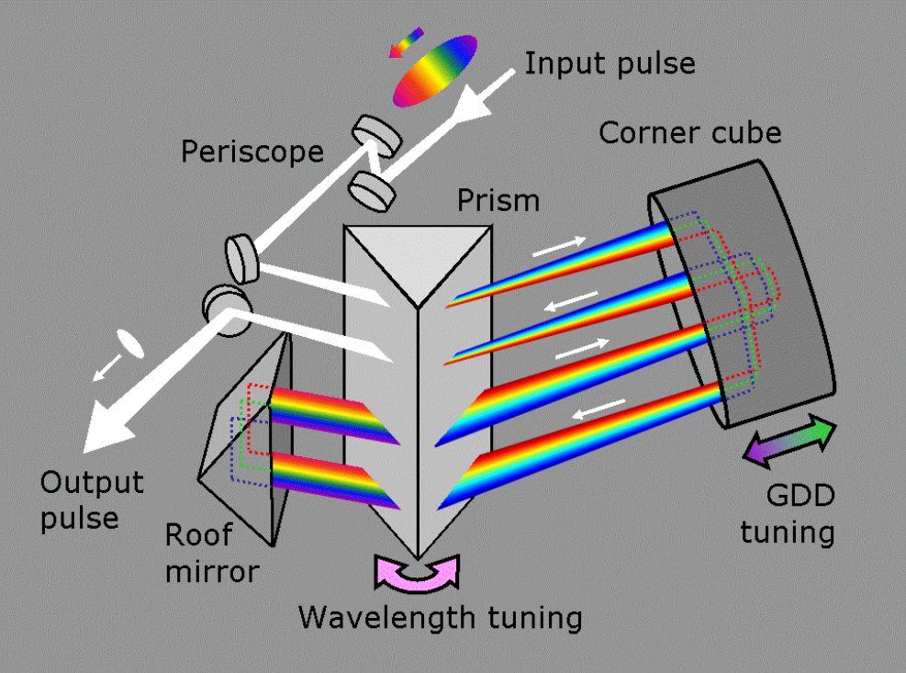
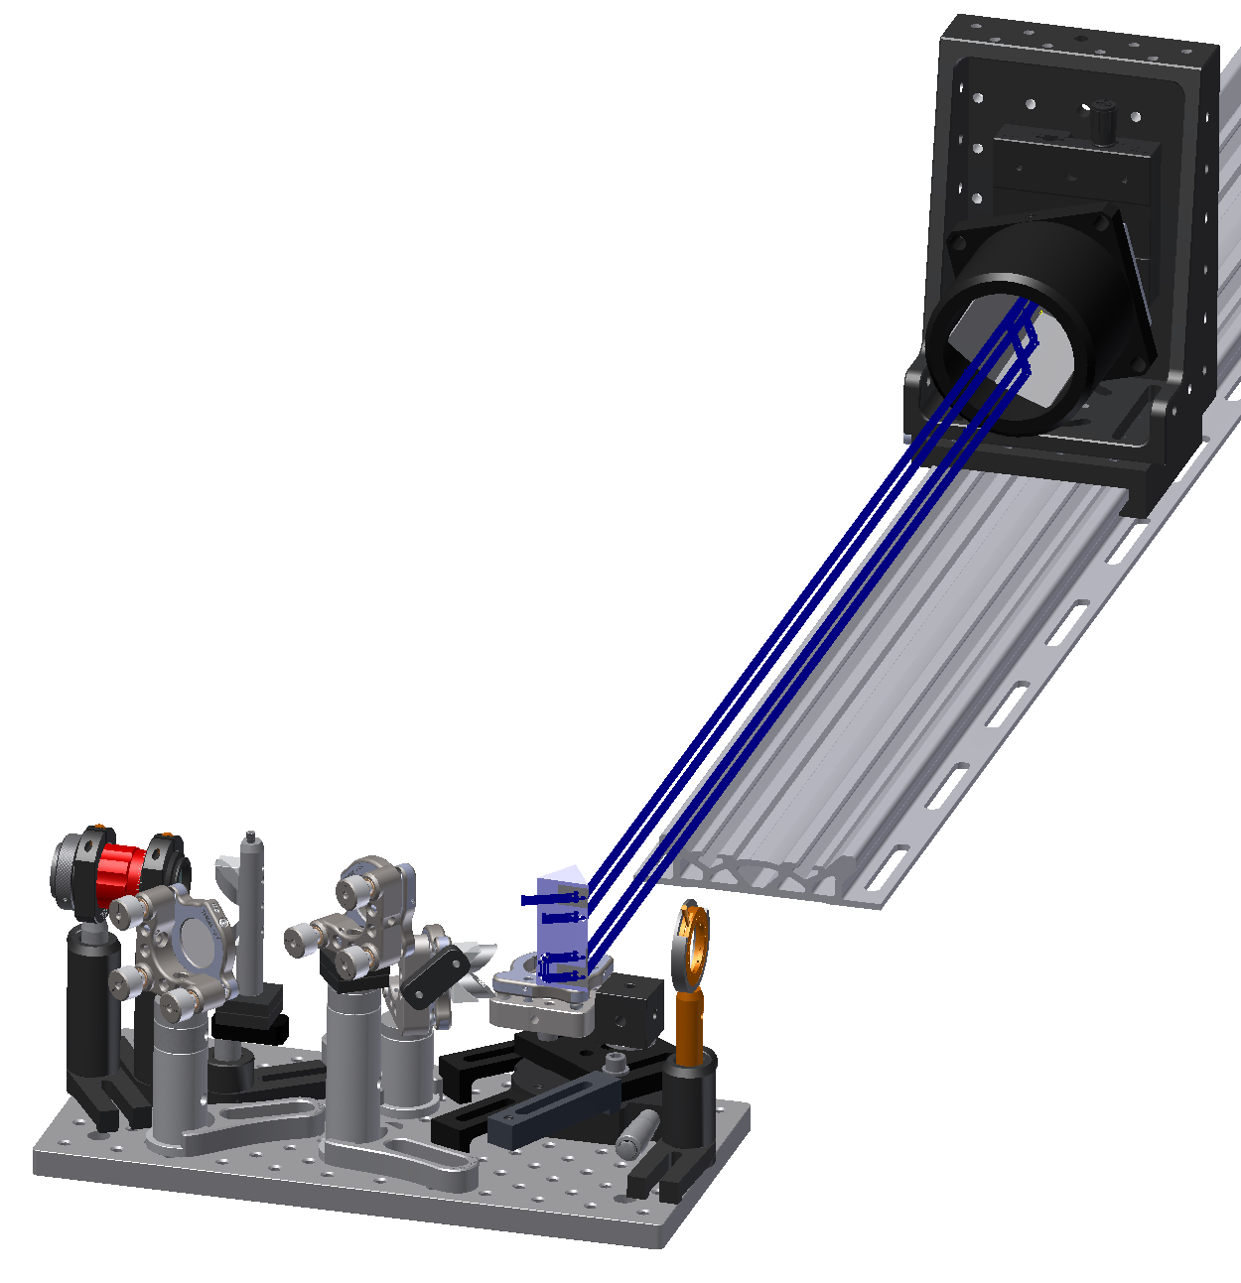
GDD comp
www.swampoptics.com
Notes:
GDD needed: measured -41000 fs^2 at 1000nm. Stretch 100fs pulse to ~1100fs
We need about 4ft sep to retroreflector
Transmission: ~62%
Cost relatively low and stable.
Manuallly adjust for wavelength, but relatively low accuracy is acceptable

Slide 21
Accessory optics
Notes:
Dispersion causes the group velocity to be slower than the phase velocity
The shape of pulse fronts and phase fronts become different after traversing an optical system
PTD is the difference between the phase front and pulse front, and in our usage we remove the constant/piston term
For an achromatic lens, at the wavelength at which the focal length is stationary, the PTD is constant
Theoretical analyses of PTD only look at simple lenses, on-axis, using paraxial approx. (no spherical aberr) so we calculate the PTD for the actual system
RMS PTD < 20 fs anywhere in field
Pk-Pk PTD < 60 fs

Slide 22
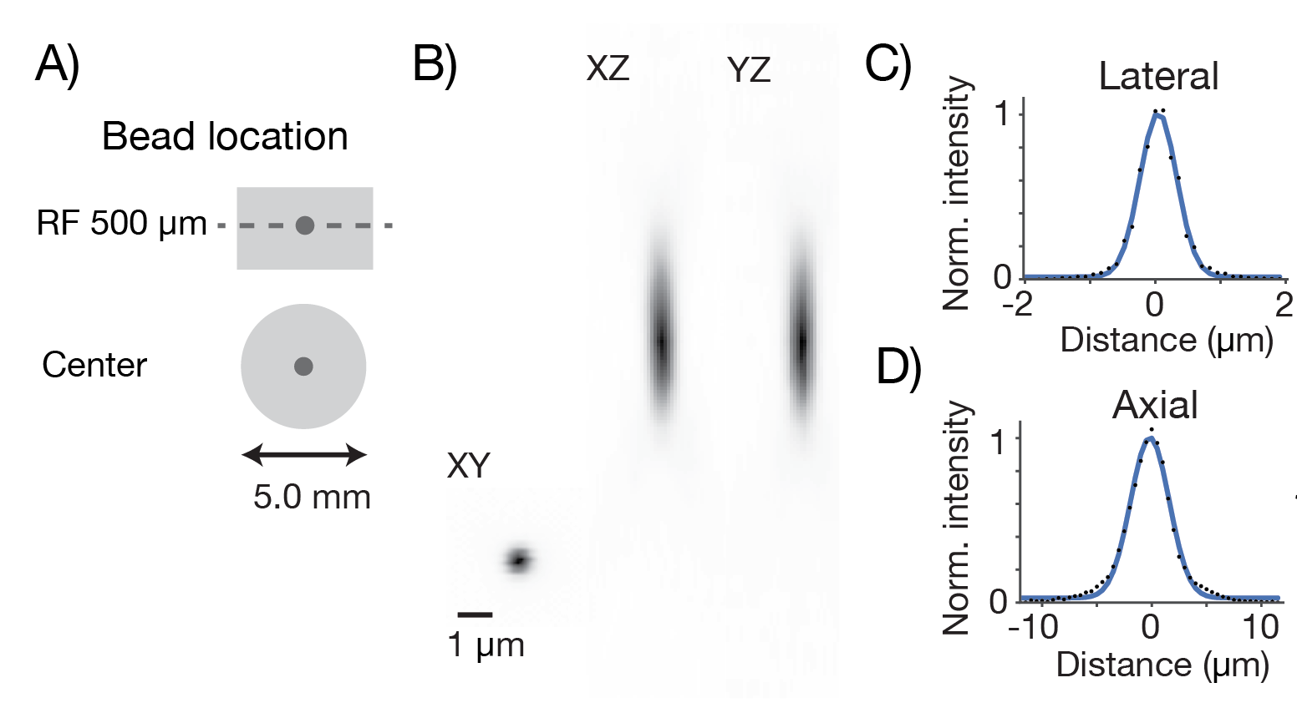
Point spread function measurements
FWHM lateral: 0.66 um
FWHM axial: 4.09 um

Slide 23
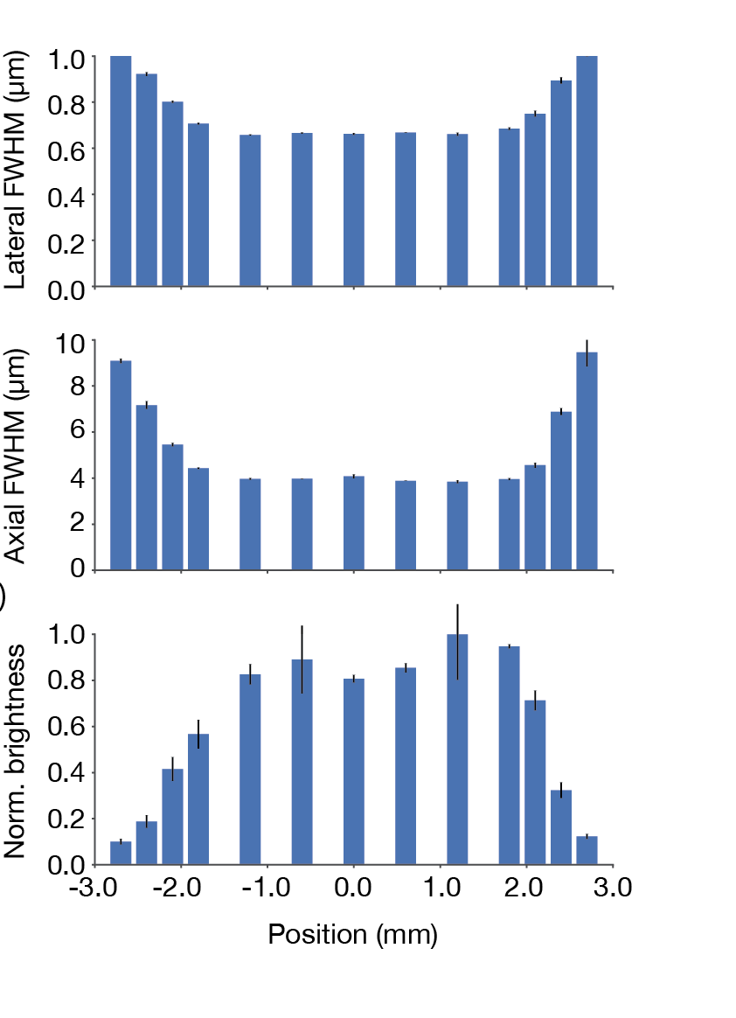
Point spread function measurements across the field

Slide 24
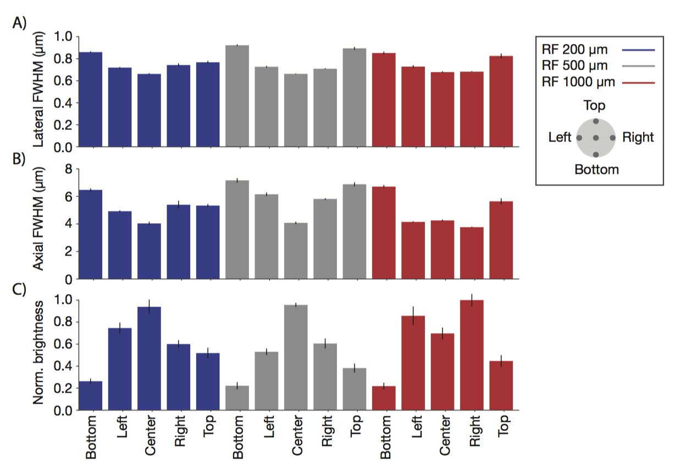
Point spread function measurements across the field

Slide 25
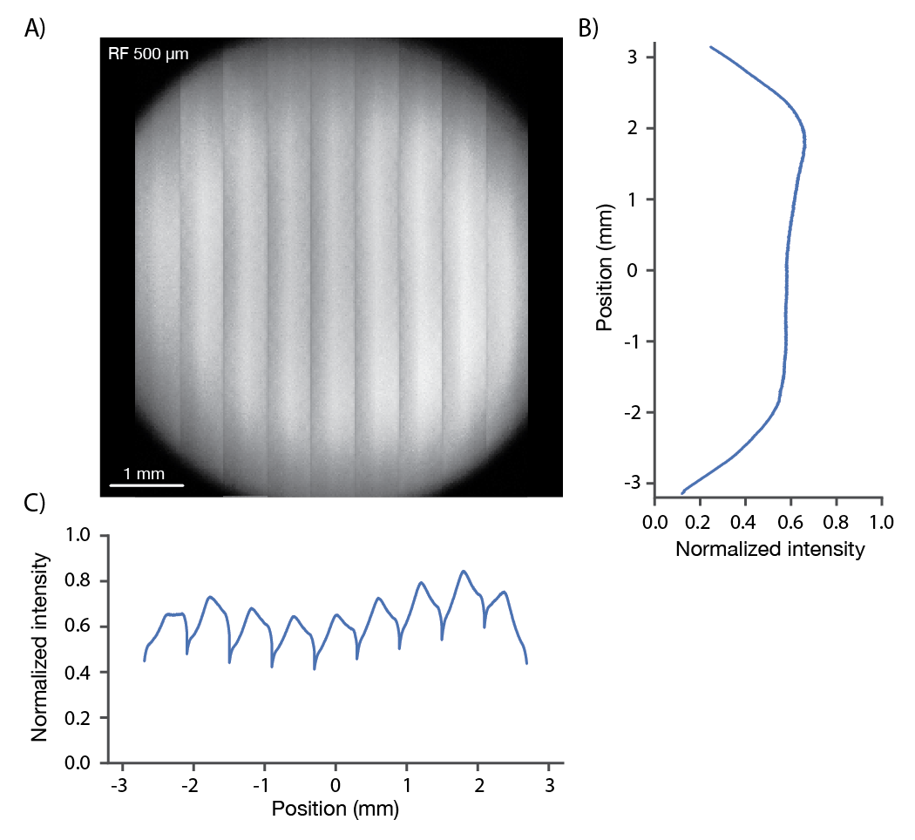
Image brightness

Slide 26
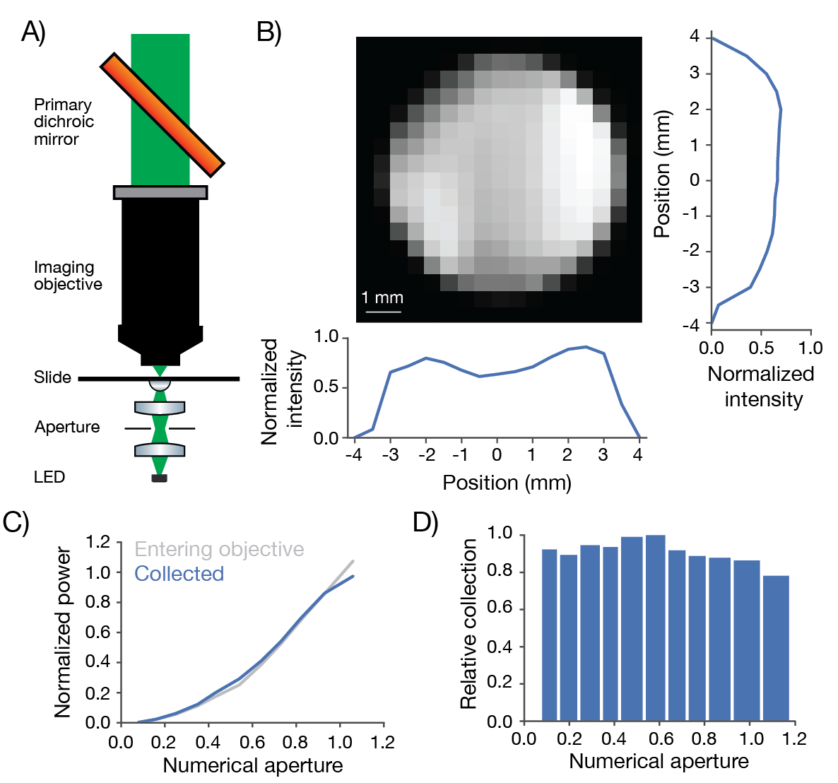
Collection efficiency

Slide 27
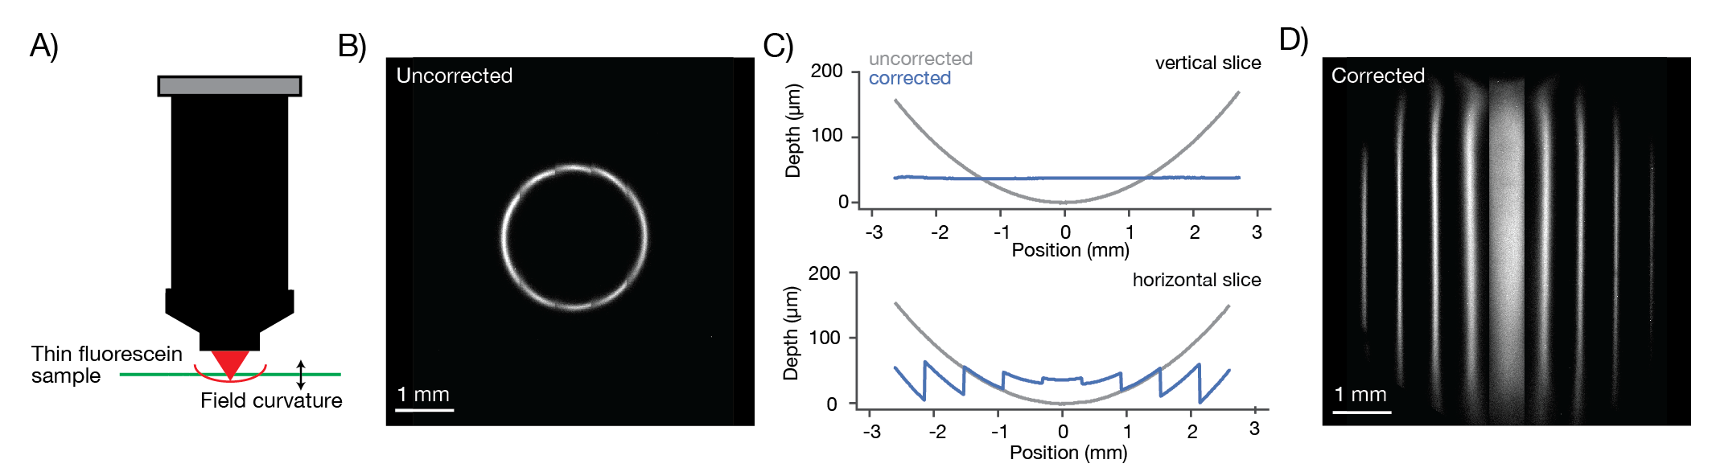
Field curvature correction

Slide 28
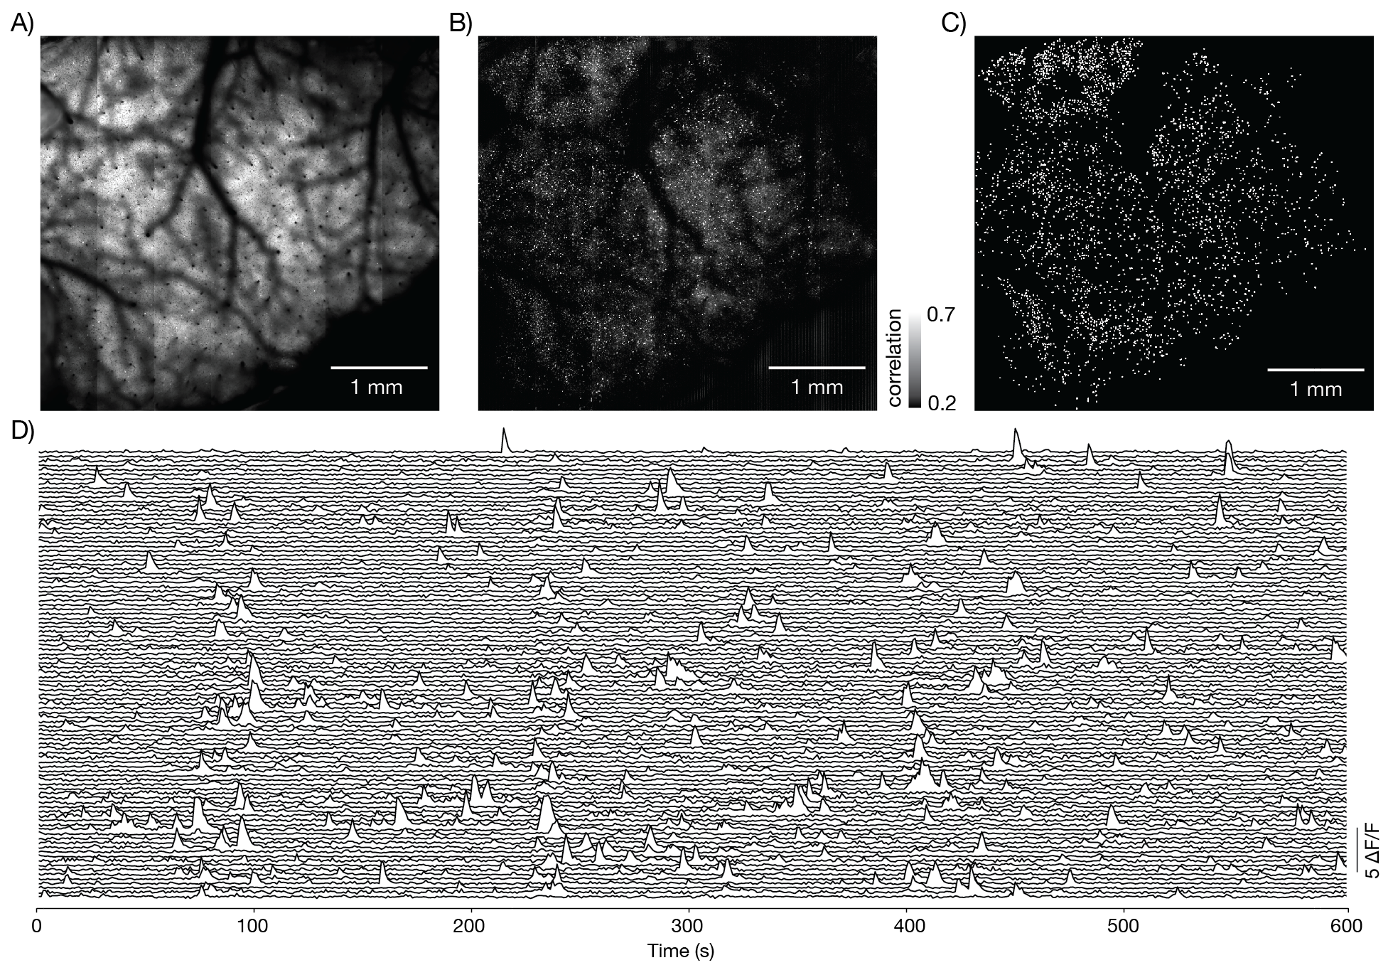

Slide 29
Movies
https://www.youtube.com/watch?v=LSYXueH1pzU
https://www.youtube.com/watch?v=p1eKi0PrqMI
https://www.youtube.com/watch?v=WGhMynyympg

Slide 30
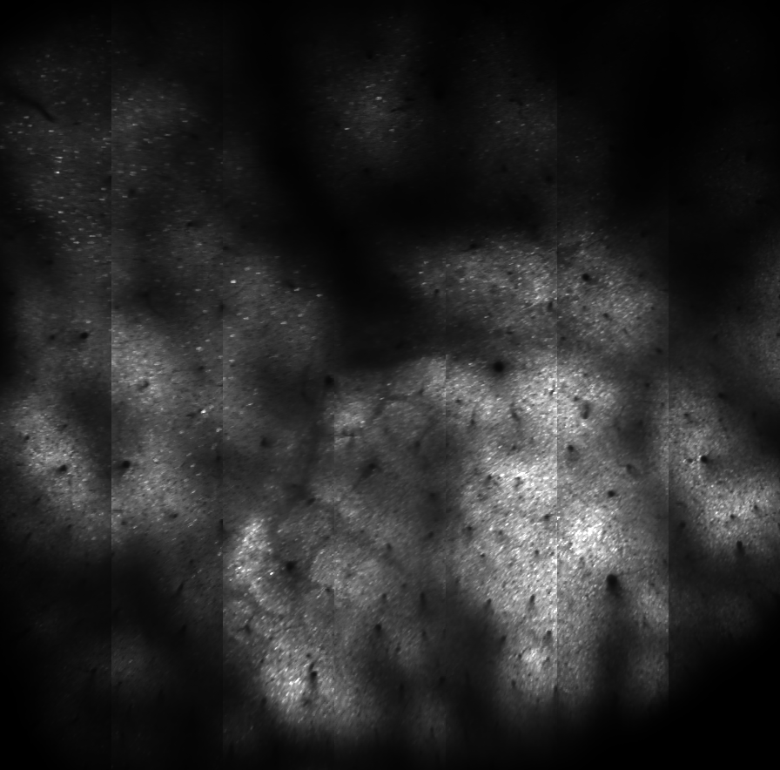
Layer 4, 450 um
Deep,
4.2 x 4.2mm
Ai94

Slide 31
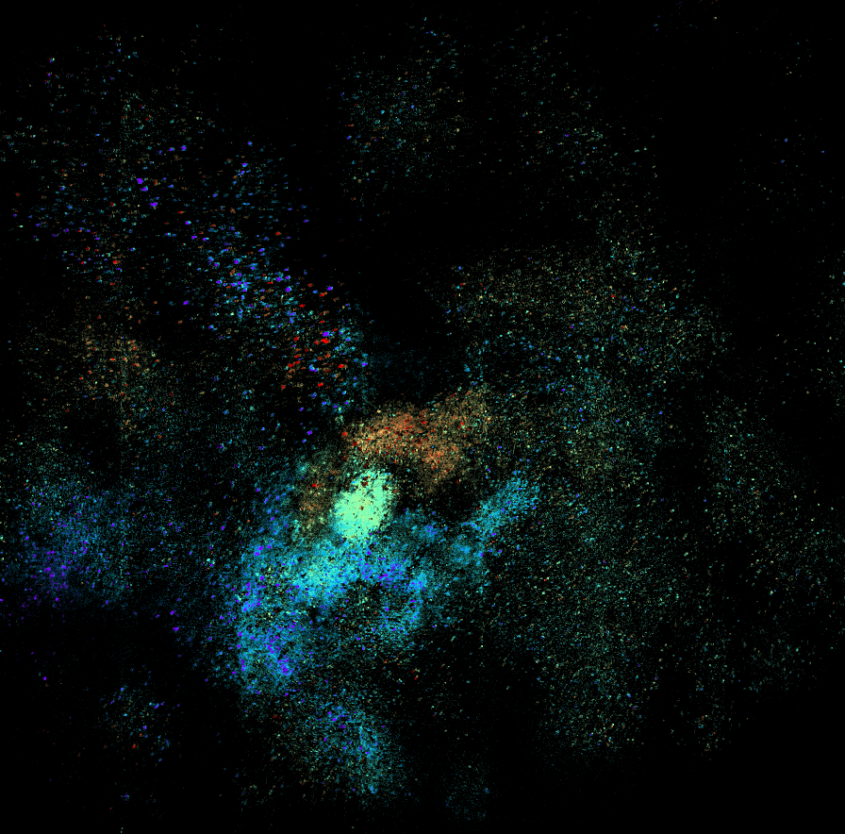
All whiskers
Wall distance tuning
Blue close, red far

